Slide 1
Help Wanted Online
A real-time measure of job postings
August 2021
Office of Research
Connecticut Department of Labor
Connecticut Department of Labor – Research Office
200 Folly Brook Blvd.
Wethersfield, CT 06109
Help Wanted Online

Slide 2
What is HWOL?
The Conference Board Help Wanted Online® Data Series (HWOL) measures the number of new, first-time Online job postings and jobs reposted from the previous month for over 50,000 Internet job boards, corporate boards and smaller job sites that serve niche markets and smaller geographic areas.
Connecticut Department of Labor – Research Office
200 Folly Brook Blvd.
Wethersfield, CT 06109
Help Wanted Online

Slide 3
Upcoming Release Dates
Monthly Report:
Wednesday, September 29th, 2021
Wednesday, October 27th, 2021
Weekly New Ads Report:
Updated every Friday
Connecticut Department of Labor – Research Office
200 Folly Brook Blvd.
Wethersfield, CT 06109
Help Wanted Online

Slide 4
Statewide Weekly New Job Ads
Weekly New job postings were 5,935 during the week ending 8/14/21.
Connecticut Department of Labor – Research Office
200 Folly Brook Blvd.
Wethersfield, CT 06109
Help Wanted Online

Slide 5
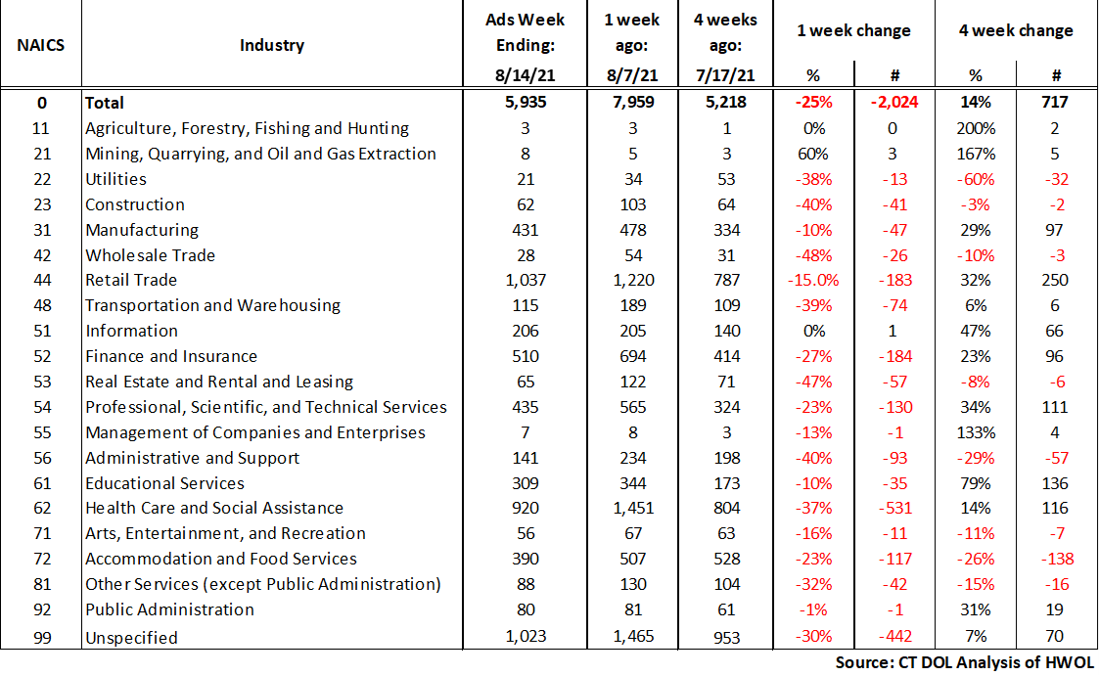
HWOL New Weekly Industry Job Ads – CT Statewide
Connecticut Department of Labor – Research Office
200 Folly Brook Blvd.
Wethersfield, CT 06109
Help Wanted Online

Slide 6
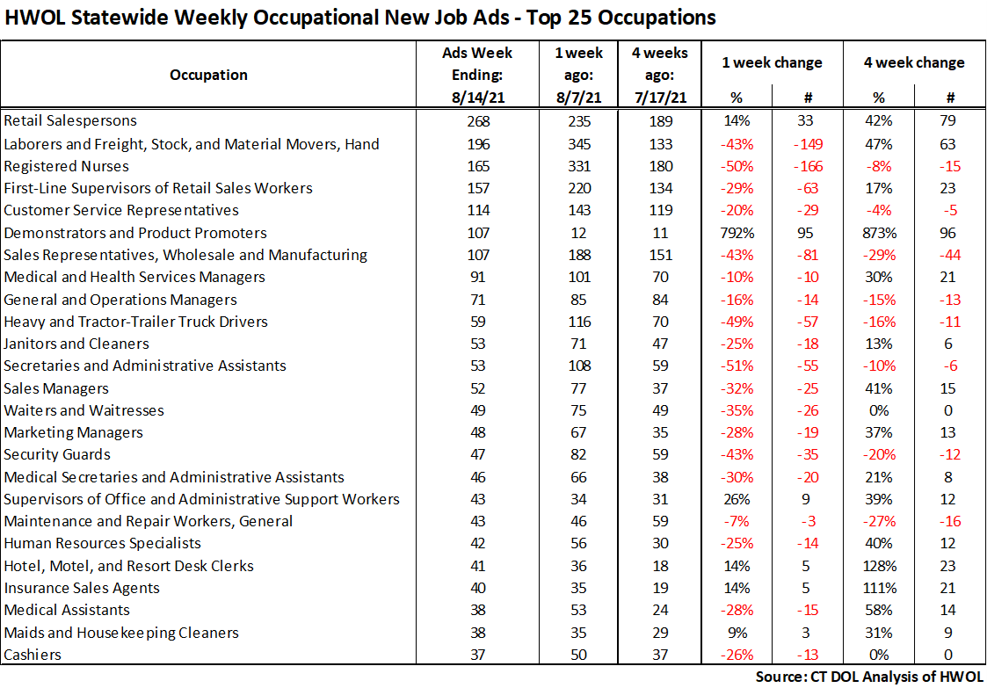
Connecticut Department of Labor – Research Office
200 Folly Brook Blvd.
Wethersfield, CT 06109
Help Wanted Online

Slide 7
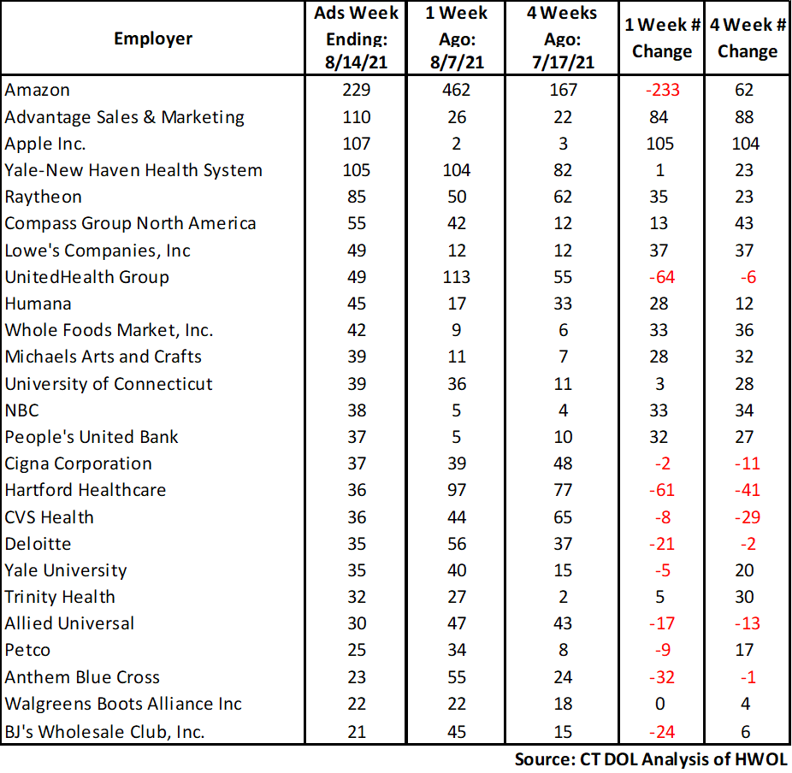
Employers with the Most New Job Postings
Connecticut Department of Labor – Research Office
200 Folly Brook Blvd.
Wethersfield, CT 06109
Help Wanted Online

Slide 8
Monthly HWOL Information
The following pages contain HWOL monthly data for July 2021.
Monthly and weekly job ad information can be found here:
https://www1.ctdol.state.ct.us/lmi/HWOL.asp
Connecticut Department of Labor – Research Office
200 Folly Brook Blvd.
Wethersfield, CT 06109
Help Wanted Online

Slide 9
Statewide Highlights
- Total postings in Connecticut was 89,171 in July 2021.
-Industry sectors with the most job postings were Health Care and Social Assistance (17499 postings), Retail Trade (11,268 postings), Finance and Insurance (7,056 posting), and Manufacturing (6,122 postings).
-Occupations with the most postings were Registered Nurses (4,068 postings), Retail Salesperson (2,733 postings), Laborers & Freight, Stock, and Material Movers (2,238 postings) Wholesale & Manufacturing Sales Representatives (2,135 postings) and Supervisors of Retail Sales Workers (2,110 postings).
Connecticut Department of Labor – Research Office
200 Folly Brook Blvd.
Wethersfield, CT 06109
Help Wanted Online

Slide 10
Connecticut Job Ads by Educational Requirements
Connecticut Department of Labor – Research Office
200 Folly Brook Blvd.
Wethersfield, CT 06109
Help Wanted Online

Slide 11
Top Certifications in Connecticut Job Ads
Connecticut Department of Labor – Research Office
200 Folly Brook Blvd.
Wethersfield, CT 06109
Help Wanted Online

Slide 12
Top Skills in Connecticut Job Ads
Connecticut Department of Labor – Research Office
200 Folly Brook Blvd.
Wethersfield, CT 06109
Help Wanted Online

Slide 13
Top Skills by Industry in Connecticut Job Ads
Connecticut Department of Labor – Research Office
200 Folly Brook Blvd.
Wethersfield, CT 06109
Help Wanted Online

Slide 14
Top Skills by Industry in Connecticut Job Ads (Continued)
Connecticut Department of Labor – Research Office
200 Folly Brook Blvd.
Wethersfield, CT 06109
Help Wanted Online

Slide 15
Connecticut Department of Labor – Research Office
200 Folly Brook Blvd.
Wethersfield, CT 06109
Help Wanted Online

Slide 16
Connecticut Employers with the Most Job Ads
Connecticut Department of Labor – Research Office
200 Folly Brook Blvd.
Wethersfield, CT 06109
Help Wanted Online

Slide 17
Connecticut Occupations with the Most Job Ads
Connecticut Department of Labor – Research Office
200 Folly Brook Blvd.
Wethersfield, CT 06109
Help Wanted Online

Slide 18
Labor Market Area Data
Labor Market Area Highlights
Job Ads by Industry
Job Ads by Location
Employers With The Most Job Ads
Occupations With The Most Job Ads
Connecticut Department of Labor – Research Office
200 Folly Brook Blvd.
Wethersfield, CT 06109
Help Wanted Online

Slide 19
Labor Market Area Highlights
Connecticut Department of Labor – Research Office
200 Folly Brook Blvd.
Wethersfield, CT 06109
Help Wanted Online

Slide 20
Connecticut Department of Labor – Research Office
200 Folly Brook Blvd.
Wethersfield, CT 06109
Help Wanted Online

Slide 21
Hartford LMA Job Ads by Location
Connecticut Department of Labor – Research Office
200 Folly Brook Blvd.
Wethersfield, CT 06109
Help Wanted Online

Slide 22
Hartford LMA Employers
with the Most Job Ads
Hartford Healthcare
Cigna Corporation
Raytheon
Accenture
CVS Health
State of Connecticut
Travelers
ICF
Connecticut Children's Medical Center
Trinity Health
Allied Universal
Disney
Wheeler Clinic
Fiserv
St. Vincent's Health Service
Pearson
Guidehouse
Lowe's Companies, Inc
Peraton Corporation
Amazon
UnitedHealth Group
University of Connecticut
Deloitte
The Hartford Financial Group
Stanley Black & Decker
Eastern Connecticut Health Network
Capitol Region Education Council
Trinity Health Of New England
Boston Market
Nelnet
Walgreens Boots Alliance Inc
The Travelers Companies, Inc
Advance Auto Parts Incorporated
Black & Veatch
American Express
Ryder System Incorporated
Genesis Healthcare Corporation
Advantage Sales & Marketing
Connecticut Department of Labor – Research Office
200 Folly Brook Blvd.
Wethersfield, CT 06109
Help Wanted Online

Slide 23
Hartford LMA Occupations
with the Most Job Ads
Connecticut Department of Labor – Research Office
200 Folly Brook Blvd.
Wethersfield, CT 06109
Help Wanted Online

Slide 24
Connecticut Department of Labor – Research Office
200 Folly Brook Blvd.
Wethersfield, CT 06109
Help Wanted Online
24

Slide 25
Bridgeport Stamford LMA Job Ads by Location
Connecticut Department of Labor – Research Office
200 Folly Brook Blvd.
Wethersfield, CT 06109
Help Wanted Online

Slide 26
Bridgeport Stamford LMA Employers
with the Most Job Ads
Amazon
Charter Communications
Lockheed Martin Corporation
Boehringer Ingelheim
Asml United States Incorporated
Compass Group North America
Synchrony
Thermo Fisher Scientific Inc
Boston Market
Petco
Stamford Group
Norwalk Public Schools
Bridgeport Public Schools
Circle K
Advantage Sales & Marketing
Starbucks Coffee Company
Fairfield University
State of Connecticut
Advance Auto Parts Incorporated
Humana
Deloitte
Yale-New Haven Health System
Allied Universal
Stamford Hospital
Norwalk Public School District
Gartner Incorporated
Hartford Healthcare
Whole Foods Market, Inc.
Griffin Health
CVS Health
KPMG
Sacred Heart University
NBC
Benchmark Senior Living
Walgreens Boots Alliance Inc
Greenwich Public Schools
UnitedHealth Group
Griffin Hospital
Connecticut Department of Labor – Research Office
200 Folly Brook Blvd.
Wethersfield, CT 06109
Help Wanted Online

Slide 27
Bridgeport Stamford LMA Occupations
with the Most Job Ads
Connecticut Department of Labor – Research Office
200 Folly Brook Blvd.
Wethersfield, CT 06109
Help Wanted Online

Slide 28
Connecticut Department of Labor – Research Office
200 Folly Brook Blvd.
Wethersfield, CT 06109
Help Wanted Online

Slide 29
New Haven LMA Job Ads by Location
Connecticut Department of Labor – Research Office
200 Folly Brook Blvd.
Wethersfield, CT 06109
Help Wanted Online

Slide 30
New Haven LMA Employers
with the Most Job Ads
Yale University
Anthem Blue Cross
Hartford Healthcare
Masonicare Corporation
Walgreens Boots Alliance Inc
Genesis Healthcare Corporation
Honeywell
Quest Diagnostics Incorporated
Petco
Quinnipiac University
Gaylord Specialty Healthcare
Compass Group North America
Advantage Sales & Marketing
Vna Community Healthcare
Boston Market
The Home Depot Incorporated
Freeman
IKEA
Sodexo
Amazon
Yale-New Haven Health System
Medtronic
Department of Veterans Affairs
Allied Universal
UnitedHealth Group
Macy's
O'Reilly Automotive Inc
State of Connecticut
CVS Health
Avangrid
Page Taft Christies
Advance Auto Parts Incorporated
University of New Haven
Fair Haven Community Health Care
Lowe's Companies, Inc
Heritage Healthcare
Ametek Incorporated
Benchmark Senior Living
Connecticut Department of Labor – Research Office
200 Folly Brook Blvd.
Wethersfield, CT 06109
Help Wanted Online

Slide 31
New Haven LMA Occupations
with the Most Job Ads
Connecticut Department of Labor – Research Office
200 Folly Brook Blvd.
Wethersfield, CT 06109
Help Wanted Online

Slide 32
Connecticut Department of Labor – Research Office
200 Folly Brook Blvd.
Wethersfield, CT 06109
Help Wanted Online

Slide 33
New London LMA Job Ads by Location
Connecticut Department of Labor – Research Office
200 Folly Brook Blvd.
Wethersfield, CT 06109
Help Wanted Online

Slide 34
New London LMA Employers
with the Most Job Ads
General Dynamics
Mohegan Sun, Inc
Pfizer
Backus Hospital
Lowe's Companies, Inc
Reliance Health Group
United States Foods
Norwich Public Schools
Hyatt
Amentum
Walgreens Boots Alliance Inc
Hersha Hospitality Management Lp
Big Night Entertainment Group
Nordson Corporation
Thames Valley Council For Community Action
The Spa At Norwich Inn
Page Taft Christies
Precision Castparts
Heritage Healthcare
Yale-New Haven Health System
Mohegan Sun
State of Connecticut
Compass Group North America
Amazon
Groton Public Schools
Sonalysts Incorporated
Advantage Sales & Marketing
Allied Universal
United Community Family Services Incorporated
Commander
Bob's Discount Furniture
CVS Health
Mashantucket Pequot Gaming
Mitchell College
Masonicare Corporation
Apple Rehab Uncasville
Marriott International Incorporated
Connecticut Department of Labor – Research Office
200 Folly Brook Blvd.
Wethersfield, CT 06109
Help Wanted Online

Slide 35
New London LMA Occupations
with the Most Job Ads
Connecticut Department of Labor – Research Office
200 Folly Brook Blvd.
Wethersfield, CT 06109
Help Wanted Online

Slide 36
Connecticut Department of Labor – Research Office
200 Folly Brook Blvd.
Wethersfield, CT 06109
Help Wanted Online

Slide 37
Danbury LMA Job Ads by Location
Connecticut Department of Labor – Research Office
200 Folly Brook Blvd.
Wethersfield, CT 06109
Help Wanted Online

Slide 38
Danbury LMA Employers
with the Most Job Ads
Amazon
Nuvance Health
Charter Communications
Ethan Allen
Maplewood At Stony Hill Llc
Genesis Healthcare Corporation
Benchmark Senior Living
Advanced Specialty Care
Mannkind Corporation
Floor Decor
State Farm Insurance Companies
Macy's
Newtown Savings Bank
Starbucks Coffee Company
BJ's Wholesale Club, Inc.
Maplewood Senior Living
Boston Market
Compass Group North America
Closets By Design Incorporated
Western Connecticut Health Network
Petco
Danbury Public Schools
UnitedHealth Group
Realogy Franchise Group LLC
Allied Universal
Whole Foods Market, Inc.
Belimo
Quest Diagnostics Incorporated
Lowe's Companies, Inc
Newtown Public School District
Western Connecticut Healthcare
CVS Health
Stew Leonards
Advantage Sales & Marketing
Entegris Incorporated
Advance Auto Parts Incorporated
Praxair
New Milford Public Schools
Connecticut Department of Labor – Research Office
200 Folly Brook Blvd.
Wethersfield, CT 06109
Help Wanted Online

Slide 39
Danbury LMA Occupations
with the Most Job Ads
Connecticut Department of Labor – Research Office
200 Folly Brook Blvd.
Wethersfield, CT 06109
Help Wanted Online

Slide 40
Connecticut Department of Labor – Research Office
200 Folly Brook Blvd.
Wethersfield, CT 06109
Help Wanted Online

Slide 41
Waterbury LMA Employers
with the Most Job Ads
Amazon
Waterbury Hospital
Mercy Medical Center Clinton
Post University
Restaurant Depot
Advance Auto Parts Incorporated
Ametek Incorporated
New Morning Market
Seasons Hospice & Palliative Care
Petco
Westover School
Aya Healthcare
Ryder System Incorporated
North West Region
Compass Group North America
Vitas Healthcare Corporation
State of Connecticut
Wheeler Clinic
United Parcel Service Incorporated
Trinity Health Of New England
Naugatuck Public Schools
Advantage Sales & Marketing
Genesis Healthcare Corporation
O'Reilly Automotive Inc
BJ's Wholesale Club, Inc.
Pep Boys
Domino's Pizza
Apple Rehab Watertown
UnitedHealth Group
Porter Chester Institute
ShopRite / Wakefern
State Farm Insurance Companies
CVS Health
Regalcare At Waterbury
Walgreens Boots Alliance Inc
Wolcott Public Schools
Marriott International Incorporated
Texas Roadhouse Incorporated
Connecticut Department of Labor – Research Office
200 Folly Brook Blvd.
Wethersfield, CT 06109
Help Wanted Online

Slide 42
Waterbury LMA Job Ads by Location
Connecticut Department of Labor – Research Office
200 Folly Brook Blvd.
Wethersfield, CT 06109
Help Wanted Online

Slide 43
Waterbury LMA Occupations
with the Most Job Ads
Connecticut Department of Labor – Research Office
200 Folly Brook Blvd.
Wethersfield, CT 06109
Help Wanted Online

Slide 44
Connecticut Department of Labor – Research Office
200 Folly Brook Blvd.
Wethersfield, CT 06109
Help Wanted Online

Slide 45
Torrington LMA Job Ads by Location
Connecticut Department of Labor – Research Office
200 Folly Brook Blvd.
Wethersfield, CT 06109
Help Wanted Online

Slide 46
Torrington LMA Employers
with the Most Job Ads
Hartford Healthcare
Torrington Public Schools
Mayflower Inn & Spa
Devereux Advanced Behavioral Health
The Hotchkiss School
Wolcott Hall
Lowe's Companies, Inc
Paws & Claws Pet Sitting And Dog Walking Services
Compass Group North America
Kent School Corporation
Alternative Employment Incorporated
State of Connecticut
Twenty2 Wallpaper
City Torrington
Hubbell Incorporated
Aspen Dental
Ed Herrington's Inc
The Arc Of Litchfield County, Inc
Amazon
Dymax Corporation
Edadvance
Western Connecticut Health Network
BJ's Wholesale Club, Inc.
Litchfield Woods Health Care Center
UnitedHealth Group
Regalcare At Torrington
Outer Armor By Commercial Sewing, Inc
United States Postal Service
Og Industries Incorporated
CVS Health
Mohawk Industries
Advanced Circuits
Staples
Svna Home Assistance
Tmc Transportation/Annett Holdings, Inc
Greater Hartford Ymca
Altra Industrial Motion Corporate
Connecticut Department of Labor – Research Office
200 Folly Brook Blvd.
Wethersfield, CT 06109
Help Wanted Online

Slide 47
Torrington LMA Occupations
with the Most Job Ads
Connecticut Department of Labor – Research Office
200 Folly Brook Blvd.
Wethersfield, CT 06109
Help Wanted Online

Slide 48
Connecticut Department of Labor – Research Office
200 Folly Brook Blvd.
Wethersfield, CT 06109
Help Wanted Online

Slide 49
Enfield LMA Job Ads by Location
Connecticut Department of Labor – Research Office
200 Folly Brook Blvd.
Wethersfield, CT 06109
Help Wanted Online

Slide 50
Enfield LMA Employers
with the Most Job Ads
Raytheon
Amazon
Advance Auto Parts Incorporated
Enfield School District
Allied Universal
Eppendorf
Hilton Hotel Corporation
Allied Community Services
CVS Health
FedEx
Sheraton
Gpm Investments Llc
Chr
Bloomin Brands, Inc
Vinfen
Burger King
United Parcel Service Incorporated
99 Restaurant Pub
Companions Homemakers Incorporated
C&S Wholesale Grocers
The Lego Group
Es3 Llc
Community Health Resources
State of Connecticut
Penske
TJX Companies, Inc.
Hertz Corporation
Reyes Holdings
Avis Budget Group, Inc.
Walgreens Boots Alliance Inc
East Windsor Public Schools
Blake Technology Corporation
Bickford Health Care Center
Butler Aerospace And Defense
Dick's Sporting Goods Incorporated
United States Postal Service
Dunkin' Donuts
Menzies Aviation
Connecticut Department of Labor – Research Office
200 Folly Brook Blvd.
Wethersfield, CT 06109
Help Wanted Online

Slide 51
Enfield LMA Occupations
with the Most Job Ads
Connecticut Department of Labor – Research Office
200 Folly Brook Blvd.
Wethersfield, CT 06109
Help Wanted Online

Slide 52
Connecticut Department of Labor – Research Office
200 Folly Brook Blvd.
Wethersfield, CT 06109
Help Wanted Online

Slide 53
Danielson LMA Job Ads by Location
Connecticut Department of Labor – Research Office
200 Folly Brook Blvd.
Wethersfield, CT 06109
Help Wanted Online

Slide 54
Danielson-Northeast LMA Employers
with the Most Job Ads
Day Kimball Healthcare
Rogers Corporation
Staples
Advance Auto Parts Incorporated
PepsiCo Inc.
Generations Family Health Center
Morgan Truck Body
Citizens Financial Group
United Natural Foods
Sonoco Products Company
Loos Company Incorporated
Thompson Public Schools
O'Reilly Automotive Inc
Putnam Plastics
Danaher Corporation
Learning Clinic Incorporated
Quikrete
Fidelity Brokerage Services
Capstone Logistics Group
Amazon
Lowe's Companies, Inc
Fm Global
Dattco
Whitcraft Company
Eastconn
Compass Group North America
Allied Universal
Woodstock Academy
Hampton
CVS Health
Dattco Travel
Walgreens Boots Alliance Inc
Spirol International Corporation
Sterling Community School
Heritage Healthcare
Walmart / Sam's
Asplundh Tree Expert Company
Maine Drilling Blasting
Connecticut Department of Labor – Research Office
200 Folly Brook Blvd.
Wethersfield, CT 06109
Help Wanted Online

Slide 55
Danielson-Northeast LMA Occupations
with the Most Job Ads
Connecticut Department of Labor – Research Office
200 Folly Brook Blvd.
Wethersfield, CT 06109
Help Wanted Online

Slide 56
All advertisement data used in this publication is from the Conference Board’s Help Wanted Online data series.
For more information or data requests, contact
Matthew Krzyzek in the Office of Research at the Department of Labor.
Matthew.Krzyzek@ct.gov
For more Connecticut Labor Market Information visit:
www.ctdol.state.ct.us/lmi
https://www.facebook.com/ctlmi
Twitter: @DOL_Research
Connecticut Department of Labor – Research Office
200 Folly Brook Blvd.
Wethersfield, CT 06109
Help Wanted Online

